Slide 1
PAST TENSE SIMPLE
ELEMENTARY LEVEL - BY C. PARLEA
CLUJ -NAPOCA

Slide 2
PINK - WHO KNEW?
https://youtu.be/NJWIbIe0N90

Slide 3
FILL IN THE SEQUENCE;
Last night I had dinner at 7 p.m., I...

Slide 4
STUDY THE Q& A
1. What did you do yesterday?
I did homework, watched TV, slept, ate, went to the mall, listened to music.
2. What was the weather like yesterday?
It was cloudy, foggy and chilly.

Slide 5
What is the difference between the two questions?
General question in the past .
Question in the past using the verb TO BE.

Slide 6
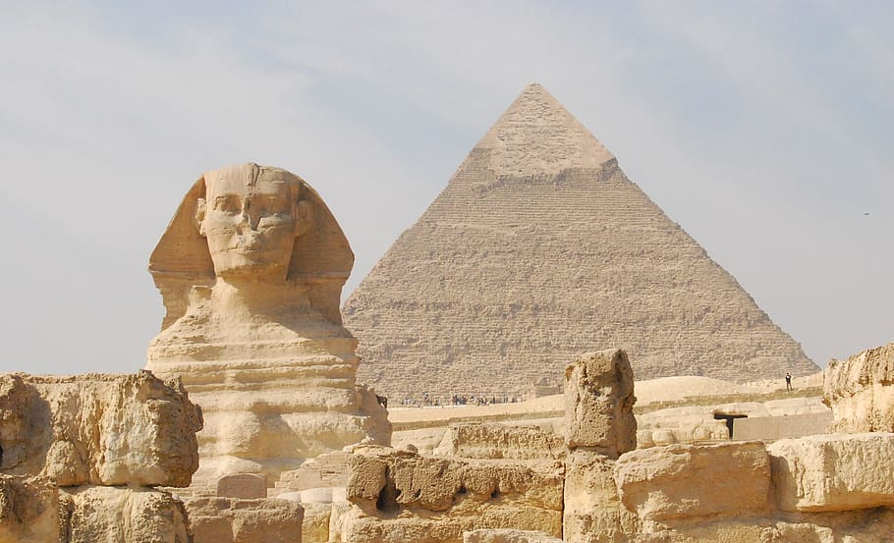
WATCH THE VIDEO IN THE LINK AND TAKE NOTES
PAST TENSE TUTORIAL
https://youtu.be/xLA58CSIf3M

Slide 7
REGULAR VERBS
REGULAR VERBS: AFFIRMATIVE: VB + ED AT THE 2ND AND 3RD FORMS He asked her to go.
V1- INFINITIVE V2 - PAST V3-PAST PARTICIPLE
TO ASK - ASKED - ASKED
TO LISTEN -LISTENED - LISTENED
TO JUMP - JUMPED - JUMPED
TO WAIT - WAITED -WAITED

Slide 8
PRONUNCIATION
ED - can be read:
/t/after k, p, s /d/ after n, y, r /id/- after t or d:
asked listened waited
jumped opened invited
worked enjoyed decided
stopped tried started

Slide 9
IRREGULAR VERBS
IRREGULAR VERBS - AFFIRMATIVE: VB 2 = DIFFERENT UNIQUE FORMS
They spoke to me.
V1- INFINITIVE V2 - PAST V3- PARTICIPLE
TO BE - WAS/WERE - BEEN
TO HAVE - HAD - HAD
TO SEE -SAW -SEEN
TO DO -DID -DONE

Slide 10
PAST SIMPLE - yes /no QUESTIONS- all verbs
WAS /WERE +SB+ OBJECTS?
Were you there? + Yes , I was/ x No.I wasn’t.
DID + SB + VB 1?
Did you have lunch? + Yes, I did. / x No, I didn’t.

Slide 11
PAST SIMPLE - Wh - QUESTIONS- all verbs
WH - WORD +WAS /WERE +SB+ OBJECTS?
Where were you yesterday? I was at home.
WH -WORD +DID + SB + VB 1?
When did you have lunch? I had lunch at 1 p.m.

Slide 12
PAST SIMPLE - NEGATIVE FORM - ALL VERBS
SB+ WASN’T/WEREN’T +OBJECTS
They weren’t at the party last weekend.
SB + DIDN’T + VB 1
He didn’t ask her to go. / They didn’t speak to me.

Slide 13
PAST SIMPLE - USES
- FOR COMPLETED ACTIONS IN THE PAST AT A DEFINITE TIME
- ADVERBS:
- Yesterday, last week, ...ago, in 2009
- WHEN+ PAST SIMPLE?

Slide 14
IRREGULAR VERB FORMS GROUPED
1. TO BUILD - BUILT - BUILT = A CONSTRUI
2. TO DREAM - DREAMT - DREAMT = A VISA
3. TO DEAL - DEALT - DEALT = A AVEA DE A FACE CU
4. TO MEAN - MEANT - MEANT = A INSEMNA

Slide 15
IRREGULAR VERB FORMS GROUPED
5. TO LEND -LENT - LENT = A DA IMPRUMUT
6. TO SEND - SENT - SENT = A TRIMITE
7. TO SMELL - SMELT - SMELT = A MIROSI
8.TO SPELL - SPELT - SPELT = A ORTOGRAFIA
9. TO SPEND - SPENT - SPENT = A PETRECE/CHELTUI

Slide 16
IRREGULAR VERB FORMS GROUPED
TO DIG -DUG -DUG = A SAPA 11. TO MAKE - MADE - MADE = A FACE
TO FIND - FOUND - FOUND = A GASI 12. TO PAY - PAID - PAID = A PLATI
TO HAVE - HAD - HAD = A AVEA 13. TO SAY - SAID - SAID = A SPUNE
TO GET - GOT -GOT = A PRIMI /OBTINE 14. TO SELL -SOLD -SOLD = A VINDE
TO HEAR - HEARD - HEARD = A AUZI 15. TO TELL - TOLD - TOLD = A POVESTI
TO HOLD - HELD - HELD = A TINE 16. TO SHINE - SHONE -SHONE = A STRALUCI
TO LAY - LAID - LAID = A PUNE/DEPUNE 17. TO SHOOT - SHOT -SHOT = A IMPUSCA
TO LEAVE - LEFT - LEFT = A LASA / PLECA 18. TO SIT - SAT - SAT = A SE ASEZA
TO LIGHT - LIT - LIT = A APRINDE 19. TO STAND - STOOD - STOOD=A STA IN PICIOARE
TO LOSE - LOST - LOST = A PIERDE 20. TO WIN - WON- WON = A CASTIGA

Slide 17
IRREGULAR VERB FORMS GROUPED
1. TO DRINK – DRANK-DRUNK = A BEA
2. TO BEGIN – BEGAN – BEGUN = A INCEPE
3. TO SWIM – SWAM –SWUM = A INOTA
4. TO RING – RANG – RUNG = A SUNA
5. TO SING – SANG – SUNG = A CANTA

Slide 18
IRREGULAR VERB FORMS GROUPED
1. TO BRING – BROUGHT –BROUGHT = A ADUCE
2. TO BUY - BOUGHT – BOUGHT = A CUMPARA
3. TO FIGHT - FOUGHT - FOUGHT = A SE LUPTA
4. TO THINK – THOUGHT -THOUGHT =A CREDE, A GANDI
5. TO CATCH – CAUGHT –CAUGHT = A PRINDE
6. TO TEACH - TAUGHT –TAUGHT = A PREDA

Slide 19
IRREGULAR VERB FORMS GROUPED
1. TO FEEL - FELT –FELT = A SIMTI
2. TO FEED - FED -FED = A HRANI
3. TO KEEP - KEPT - KEPT - A PASTRA
4. TO MEET - MET - MET = A INTALNI
5. TO SLEEP - SLEPT - SLEPT = A DORMI
6. TO SWEEP -SWEPT - SWEPT = A MATURA

Slide 20
IRREGULAR VERB FORMS GROUPED
TO BREAK -BROKE - BROKEN = A SPARGE
TO CHOOSE - CHOSE - CHOSEN = A ALEGE
TO STEAL - STOLE -STOLEN = A FURA
TO SPEAK - SPOKE - SPOKEN - A VORBI
TO FREEZE - FROZE - FROZEN = A INGHETA
TO WAKE - WOKE - WOKEN = A SE TREZI

Slide 21
IRREGULAR VERB FORMS GROUPED
TO DRIVE - DROVE -DRIVEN = A SOFA
TO RIDE -RODE - RIDDDEN = A INCALECA
TO RISE - ROSE -RISEN = A SE RIDICA
TO WRITE - WROTE - WRITTEN = A SCRIE

Slide 22
IRREGULAR VERB FORMS GROUPED
TO BLOW -BLEW - BLOWN = A SUFLA
TO FLY - FLEW -FLOWN = A ZBURA
TO GROW - GREW - GROWN = A CRESTE
TO KNOW - KNEW - KNOWN = A STI
TO THROW -THREW - THROWN = A ARUNCA
TO DRAW - DREW - DRAWN = A DESENA

Slide 23
IRREGULAR VERB FORMS GROUPED
TO BURST -BURST -BURST = A IZBUCNI
TO COST - COST - COST = A COSTA
TO CUT -CUT -CUT = A TAIA
TO HIT -HIT - HIT= A LOVI
TO HURT - HURT - HURT = A RANI
TO LET - LET - LET = A LASA
TO PUT - PUT -PUT = A PUNE
TO SET - SET - SET = A ASEZA , A STABILI
TO SHUT - SHUT - SHUT = A INCHIDE

Slide 24
WHO KNEW - PINK
LISTEN TO THE SONG AGAIN AND MAKE A LIST OF ALL THE VERBS IN THE PAST THAT APPEAR IN THE SONG!
https://youtu.be/NJWIbIe0N90

